Slide 1

Questions
Group 670

Slide 2

CONTENT
GENERAL GUIDELINES
STUDENTS
PBL
RESEARCH AND RANKING
BUSINESS COLLABORATION
STRATEGY 2016-21

Slide 3
Another MPPT algorithm: Constant voltage
Pro:
Using only a voltage sensor
A simple loop for control
Contra:
The method can’t handle a change in environmental condition (temperature, partial shading)
Notes:
with strong temperature fluctuation the assumption of linear dependence is no longer valid
For a partial shaded PV panel the P-V curve has got multiple local maxima and the method can‘t handle this

Slide 4
Another MPPT algorithm: Fuzzy logic control
Pro:
inputs can be imprecise
not needing an accurate mathematical model
handling nonlinearity
performing well under varying environmental condition
Contra:
The method can’t handle a change in environmental condition (temperature, partial shading)
Notes:
with strong temperature fluctuation the assumption of linear dependence is no longer valid
For a partial shaded PV panel the P-V curve has got multiple local maxima and the method can‘t handle this

Slide 5
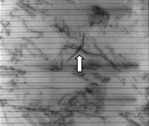
Why bidirectional ?
Extracting and injecting current from the PV panel
Injection current:
Because of electroluminescence
the PV panel emits light for
detection microcracks
Microcracks:
The orientation is important for
causing power losses.
The most critical one is parallel to the
busbars.
Electroluminescence image of a PV panel [1]
[1]https://www.sensovation.com/
com/Applications/Photovoltaic

Slide 6
When does the MIC make sense in terms of cost/energy/efficiency ?
Optimal power production efficiency with missmatches
System cost
System cost per watt
Based on a 10 kW series-string MC, or MI PV systems.
One MC or MI for one PV panel
Reference: Efficiency and Cost Trade-Offs for Designing Module Integrated Converter Photovoltaic Systems

Slide 7
Errors in the report
non inverting buck boost converter is wrong as the ground connection is missing, this happens at least three times in different figures (2.3, 2.4 and 3.1).
wrong legend in ‘valg’ mapping diagram (Figure 5.2).
Calculation of maximum mics (equation 2.2) is wrong.

Slide 8
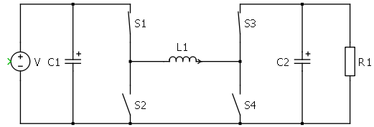
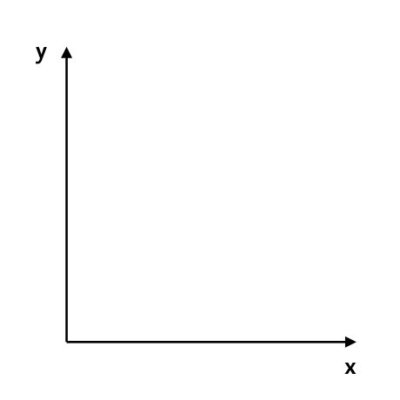


DCM
MOSFETs do not prevent reverse current like a diode would.
DCM mode is never reached when working with the 4 transistors.
Instead current would be negative through the couil.
$$I_{L}$$
$$t$$

Slide 9
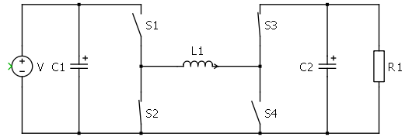
DCM
MOSFETs do not prevent reverse current like a diode would.
DCM mode is never reached when working with the 4 transistors.
Instead current would be negative through the couil.
$$I_{L}$$
$$t$$

Slide 10
DCM
MOSFETs do not prevent reverse current like a diode would.
DCM mode is never reached when working with the 4 transistors.
Instead current would be negative through the couil.
$$I_{L}$$
$$t$$

Slide 11
DCM
MOSFETs do not prevent reverse current like a diode would.
DCM mode is never reached when working with the 4 transistors.
Instead current would be negative through the couil.
$$I_{L}$$
$$t$$

Slide 12
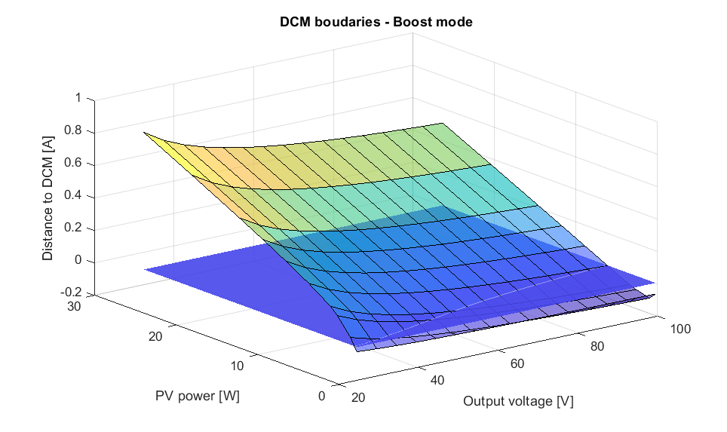
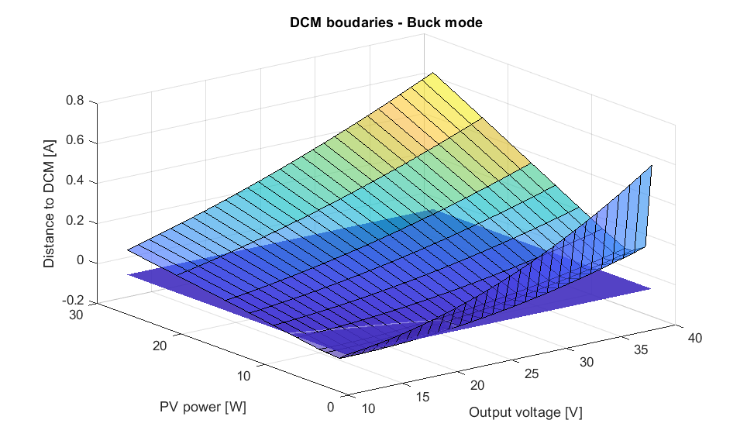
DCM
DCM mode depends on output voltage and power generated.

Slide 13
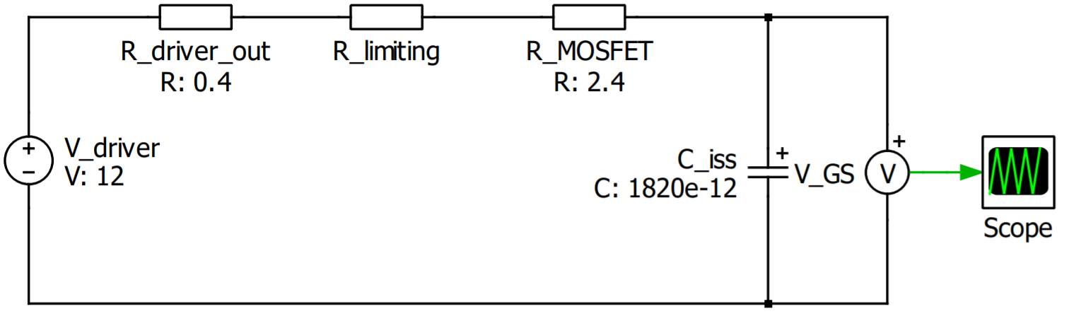

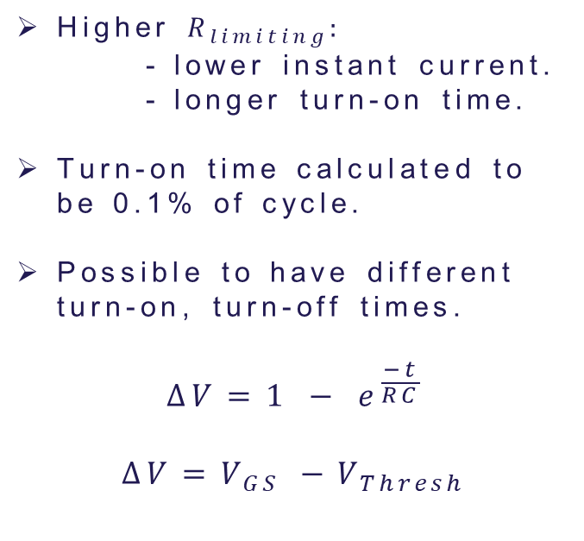
Limiting resistance
OUT H
$$R_{limiting}$$
Higher $R_{limiting}:$
- lower instant current.
- longer turn-on time.
Turn-on time calculated to be 0.1% of cycle.
Possible to have different turn-on, turn-off times.
$$∆V=1 − e^{\frac{−t}{RC}}$$
$$∆V=V_{GS} −V_{Thresh}$$
PWM
DRV
OUT L

Slide 14


Discharging resistance
Higher $R_{limiting}:$
- lower instant current.
- longer turn-on time.
Turn-on time calculated to be 0.1% of cycle.
Possible to have different turn-on, turn-off times.
$$∆V=1 − e^{\frac{−t}{RC}}$$
$$∆V=V_{GS} −V_{Thresh}$$
$$R_{discharge}$$
$$C_{iss}$$

